Slide 1
Milvus Vector Database:
Integrating Semantic Search Capabilities with .NET and Azure
Timothy Spann

Slide 2




Speaker
Tim Spann
Principal Developer Advocate, Zilliz
tim.spann@zilliz.com
https://www.linkedin.com/in/timothyspann/
https://x.com/PaaSDev

Slide 3
Intro to Vector Databases
Agenda
Milvus with .NET
Milvus on Azure
Insights

Slide 4
01
Introduction

Slide 5
Why Vector Databases?
Unstructured Data is 80% of data
Vector Databases are the only type of database that can work with unstructured data - Examples of Unstructured Data include text, images, videos, audio, etc

Slide 6
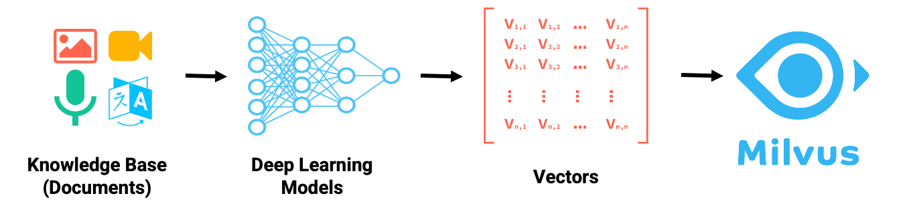

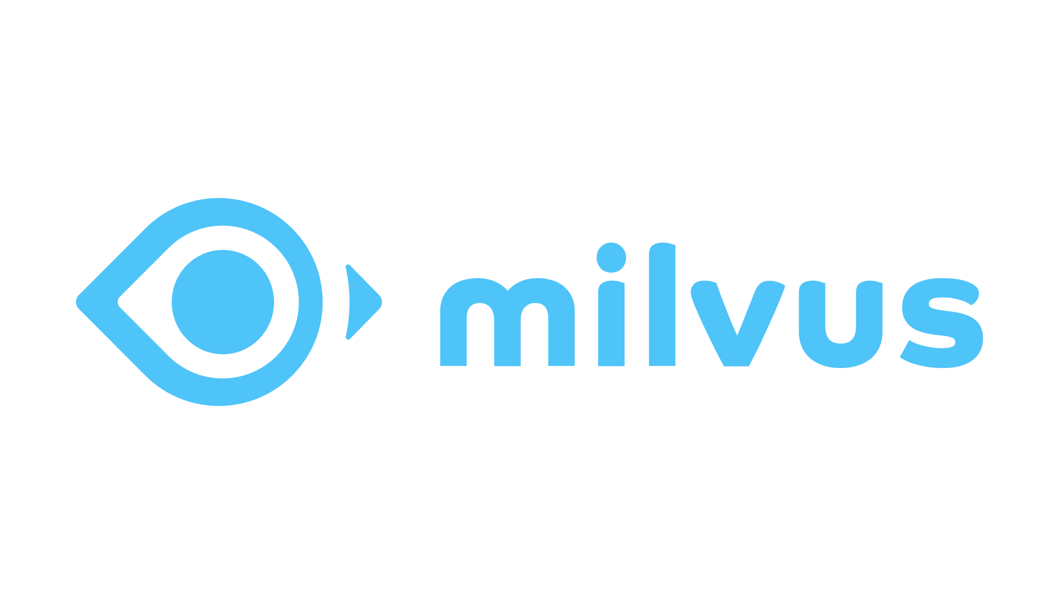
Where do Vectors Come From?
Vector Databases

Slide 7
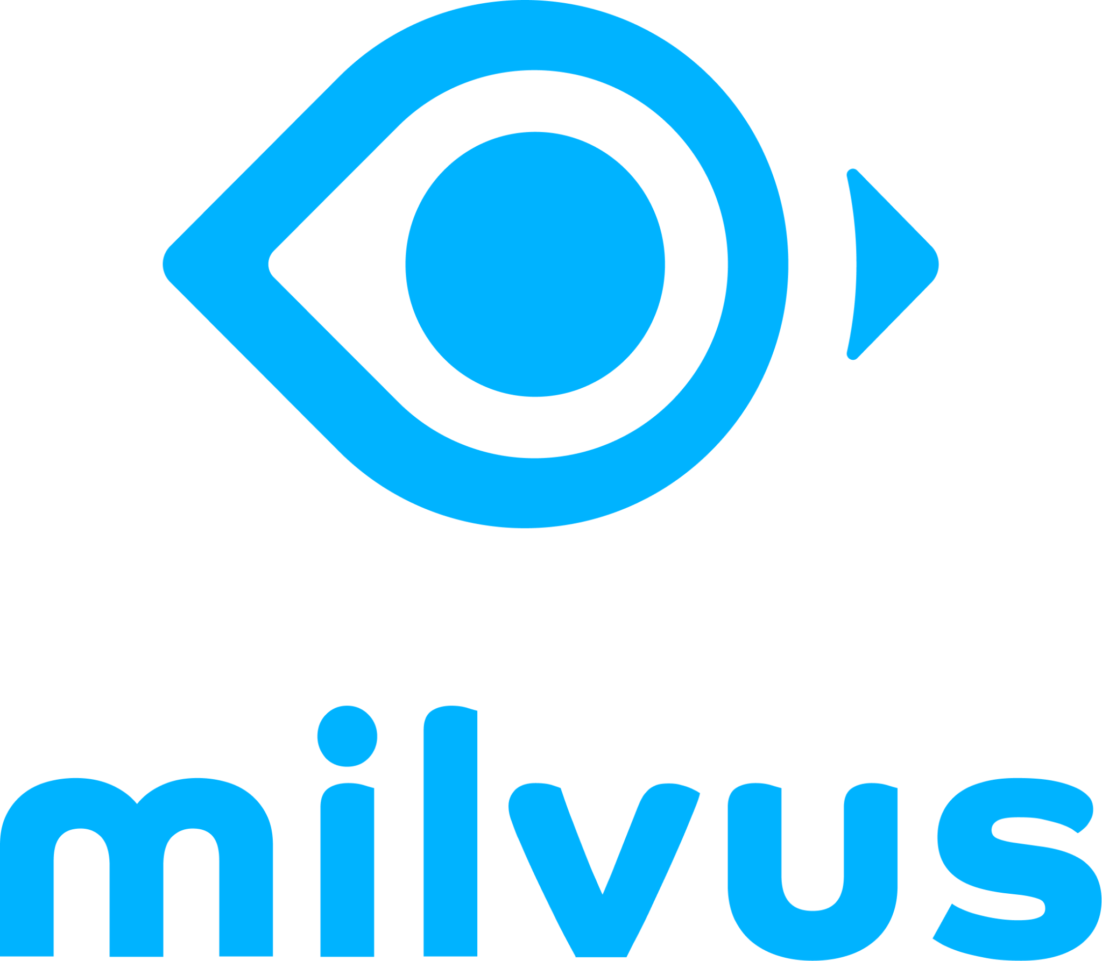









Easy Setup
Pip-install to start coding in a notebook within seconds.
Reusable Code
Write once, and deploy with one line of code into the production environment
Integration
Plug into OpenAI, Langchain, LlmaIndex, and many more
Feature-rich
Dense & sparse embeddings, filtering, reranking and beyond
Milvus is an open-source vector database for GenAI projects. pip install on your laptop, plug into popular AI dev tools, and push to production with a single line of code.
27K+
2,600+
25M+
250+
GitHub Stars
Forks
Downloads
Contributors
Notes:
Hi everyone, I'm [Your Name], part of the DevRel team at Zilliz, the creators and key maintainers of the open-source vector database, Milvus, which you might already be familiar with. It has graduated from Linux AI & Data foundation and been quite popular in the AI community, boasting over 27,000 stars on GitHub. The cool part? You can start Milvus with just a single line of code on your Jupyter notebooks or laptops. It's equipped with powerful features like hybrid search, capable of handling both sparse and dense embeddings, metadata filtering for pinpoint accuracy, and upsert capabilities that ensure real-time data updates with atomicity, and much more.
Milvus has been integrated with leading AI frameworks and tools like OpenAI, LlamaIndex, and Langchain, so you can begin crafting your GenAI projects in just minutes.

Slide 8
What is Milvus ideal for?
Purpose-built to store, index and query vector embeddings from unstructured data at scale.
Advanced filtering
Hybrid search
Durability and backups
Replications/High Availability
Sharding
Aggregations
Lifecycle management
Multi-tenancy
High query load
High insertion/deletion
Full precision/recall
Accelerator support (GPU, FPGA)
Billion-scale storage

Slide 9




We’ve built technologies for various types of use cases
Index Types
Offer a wide range of 15 indexes support, including popular ones like HNSW, PQ, Binary, Sparse, DiskANN and GPU index
Empower developers with tailored search optimizations, catering to performance, accuracy and cost needs
Search Types
Support multiple types such as top-K ANN, Range ANN, sparse & dense, multi-vector, grouping, and metadata filtering
Enable query flexibility and accuracy, allowing developers to tailor their information retrieval needs
Multi-tenancy
Enable multi-tenancy through collection and partition management
Allow for efficient resource utilization and customizable data segregation, ensuring secure and isolated data handling for each tenant
Compute Types
Designed for various compute powers, such as AVX512, Neon for SIMD, quantization cache-aware optimization and GPU
Leverage strengths of each hardware type, ensuring high-speed processing and cost-effective scalability for different application needs

Slide 10









Search across various types of unstructured data
Retrieval Augmented Generation (RAG)
Recommender System
Text/ Semantic Search
Match user behavior or content features with other similar ones to make effective recommendations.
Search for semantically similar texts across vast amounts of natural language documents.
Expand LLMs' knowledge by incorporating external data sources into LLMs and your AI applications.
Image Similarity Search
Video Similarity Search
Audio Similarity Search
Identify and search for visually similar images or objects from a vast collection of image libraries.
Search for similar videos, scenes, or objects from extensive collections of video libraries.
Find similar audios in large datasets for tasks like genre classification or speech recognition
Molecular Similarity Search
Anomaly Detection
Multimodal Similarity Search
Search for similar substructures, superstructures, and other structures for a specific molecule.
Detect data points, events, and observations that deviate significantly from the usual pattern
Search over multiple types of data simultaneously, e.g. text and images

Slide 11
02
Milvus with .NET

Slide 12

.NET SDK
C# SDK
dotnet add package Milvus.Client --version 2.2.2-preview.6
Requirement
.NET Core 2.1+
.NET Framework 4.6.1+
https://milvus.io/docs/v2.2.x/install-csharp.md
https://github.com/milvus-io/milvus-sdk-csharp

Slide 13
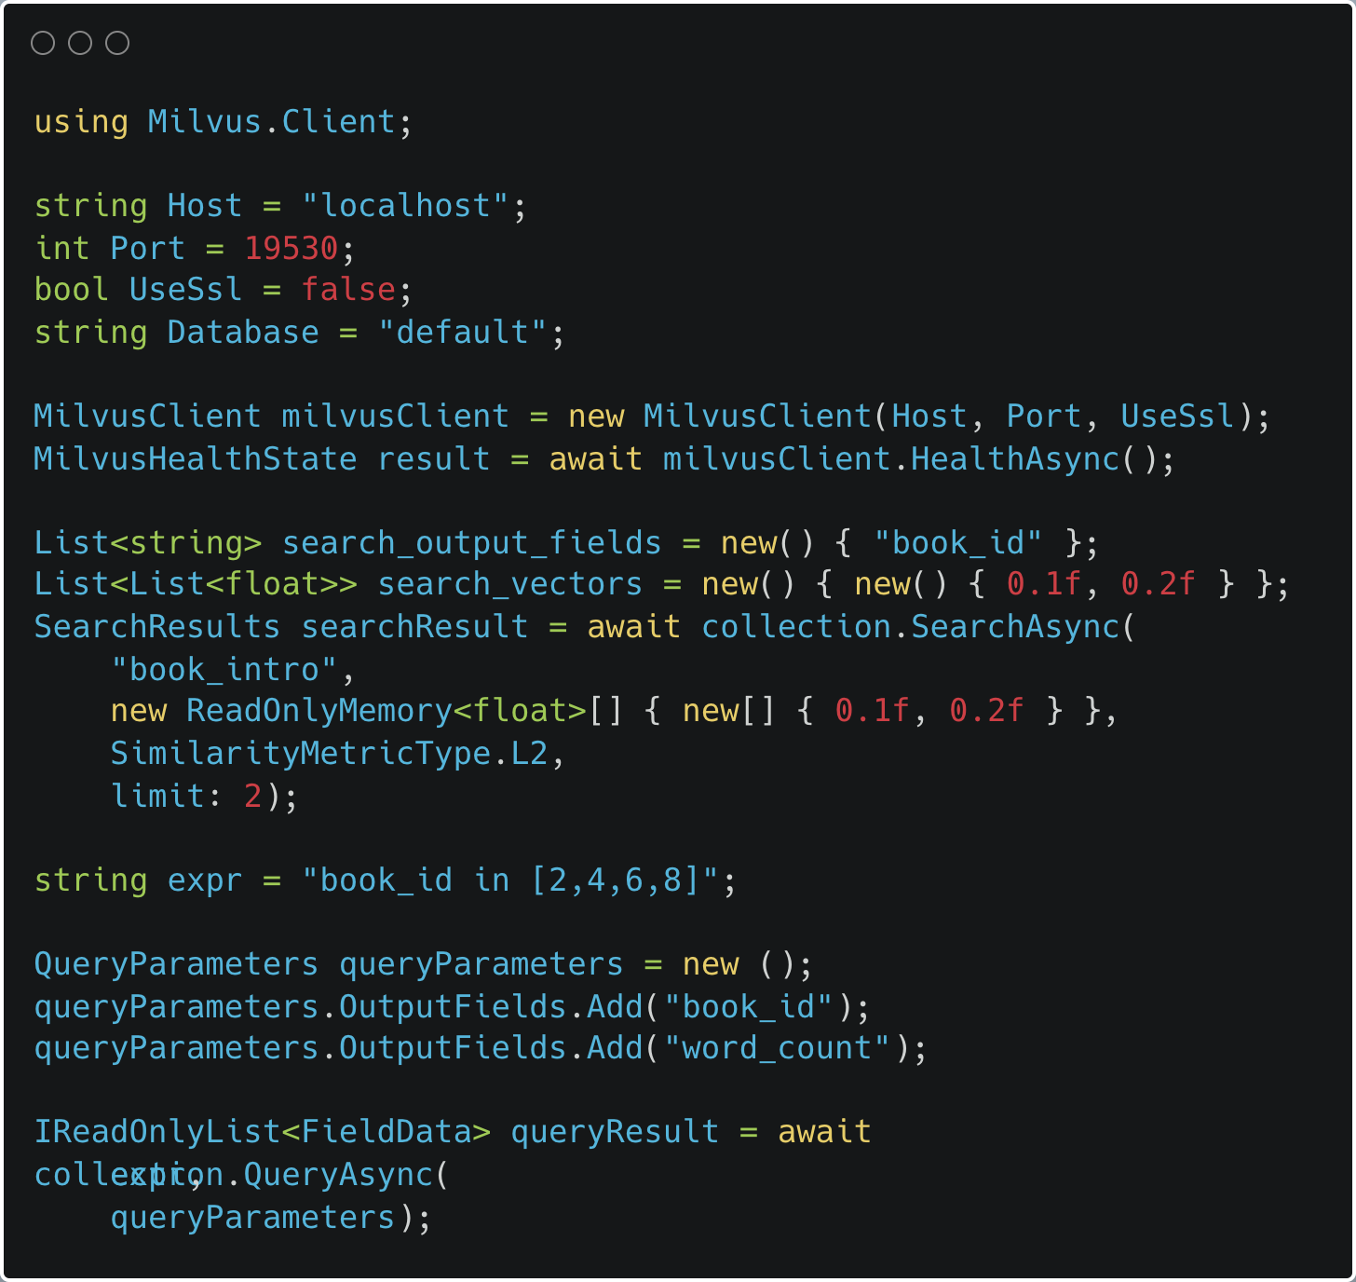
.NET C# Example

Slide 14
03
Milvus on Azure

Slide 15

Milvus on Azure
Kubernetes / AKS
Software requirements
Azure CLI
kubectl
Helm
https://milvus.io/docs/azure.md
https://azure.microsoft.com/en-us/products/kubernetes-service/

Slide 16
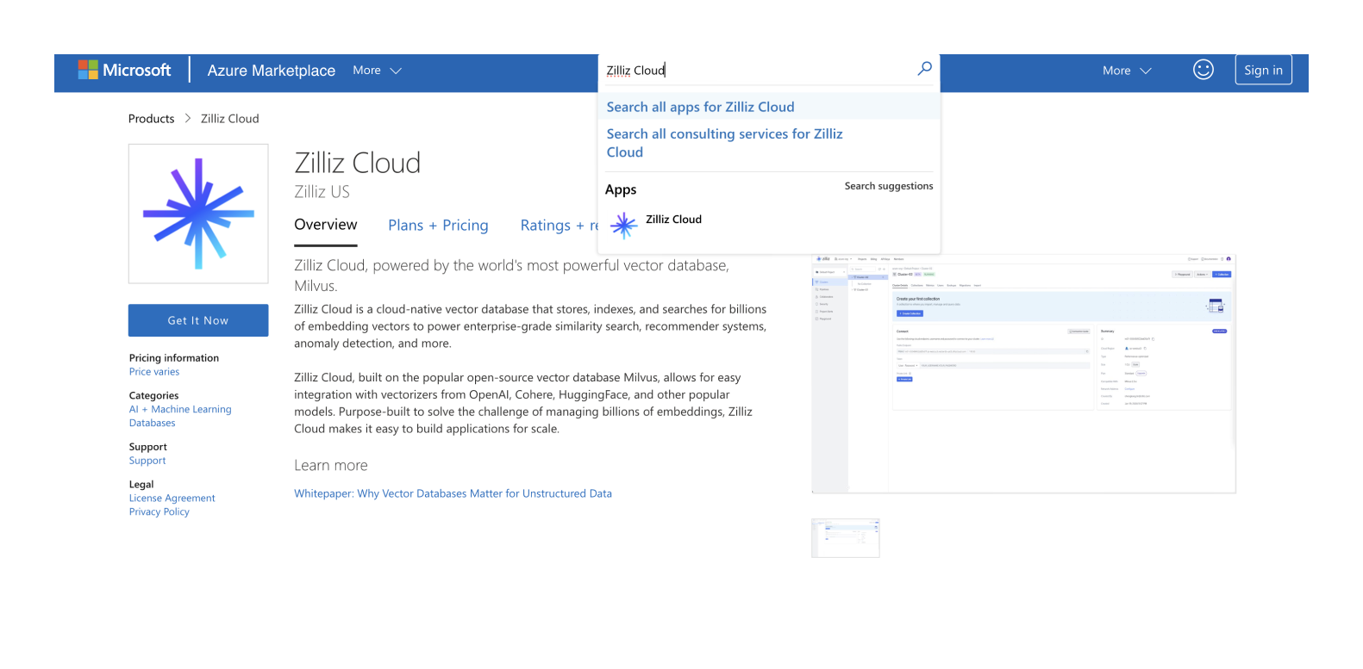
Milvus on Azure Marketplace
https://docs.zilliz.com/docs/subscribe-on-azure-marketplace

Slide 17






We provide deployment flexibility for different operational, security and compliance requirements
SELF MANAGED SOFTWARE
FULLY MANAGED SERVICE
Milvus
Most widely-adopted open source vector database
Zilliz Cloud
Milvus Re-engineered for the Cloud
Self hosted on any machine with community support
Available in public clouds
Local
Docker
K8s

Slide 18
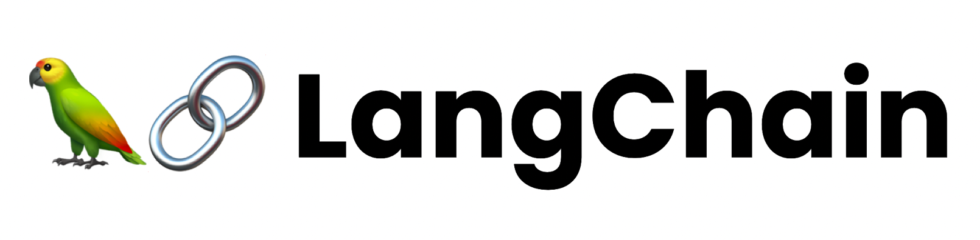
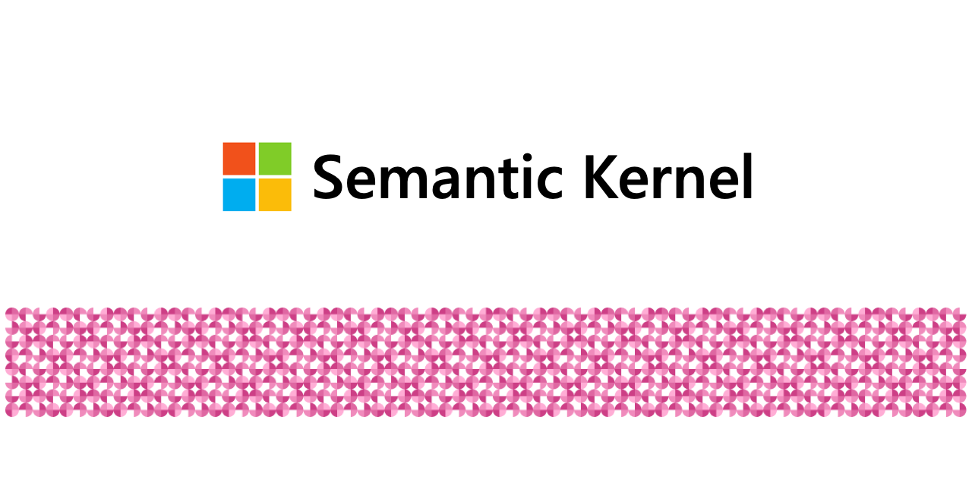
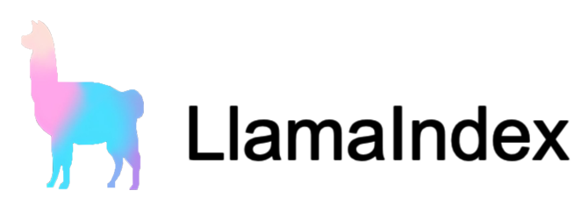





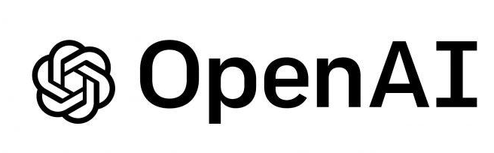




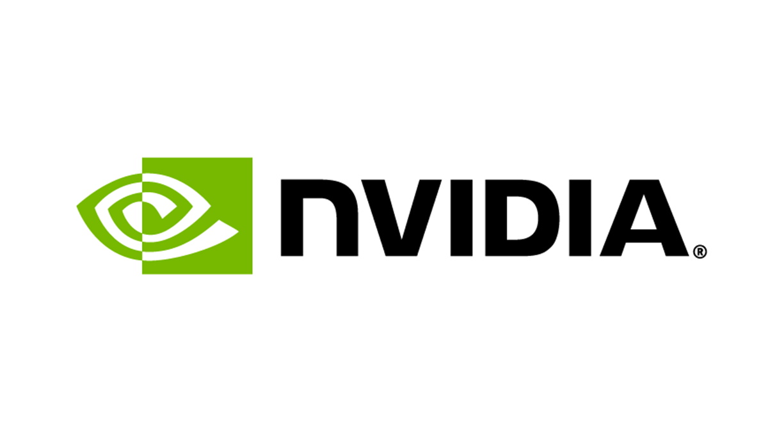

Well-connected in LLM infrastructure to enable RAG use cases
Framework
Software Infrastructure
Embedding Models
Vector Database
LLMs
Hardware
Infrastructure

Slide 19
04
Insights

Slide 20
Takeaways
Open Source for community
Many use cases require different indexes and searches
Run your Milvus Cluster on Azure
Keep your Vector Database Close to Your Gen AI
Scalability is important

Slide 21
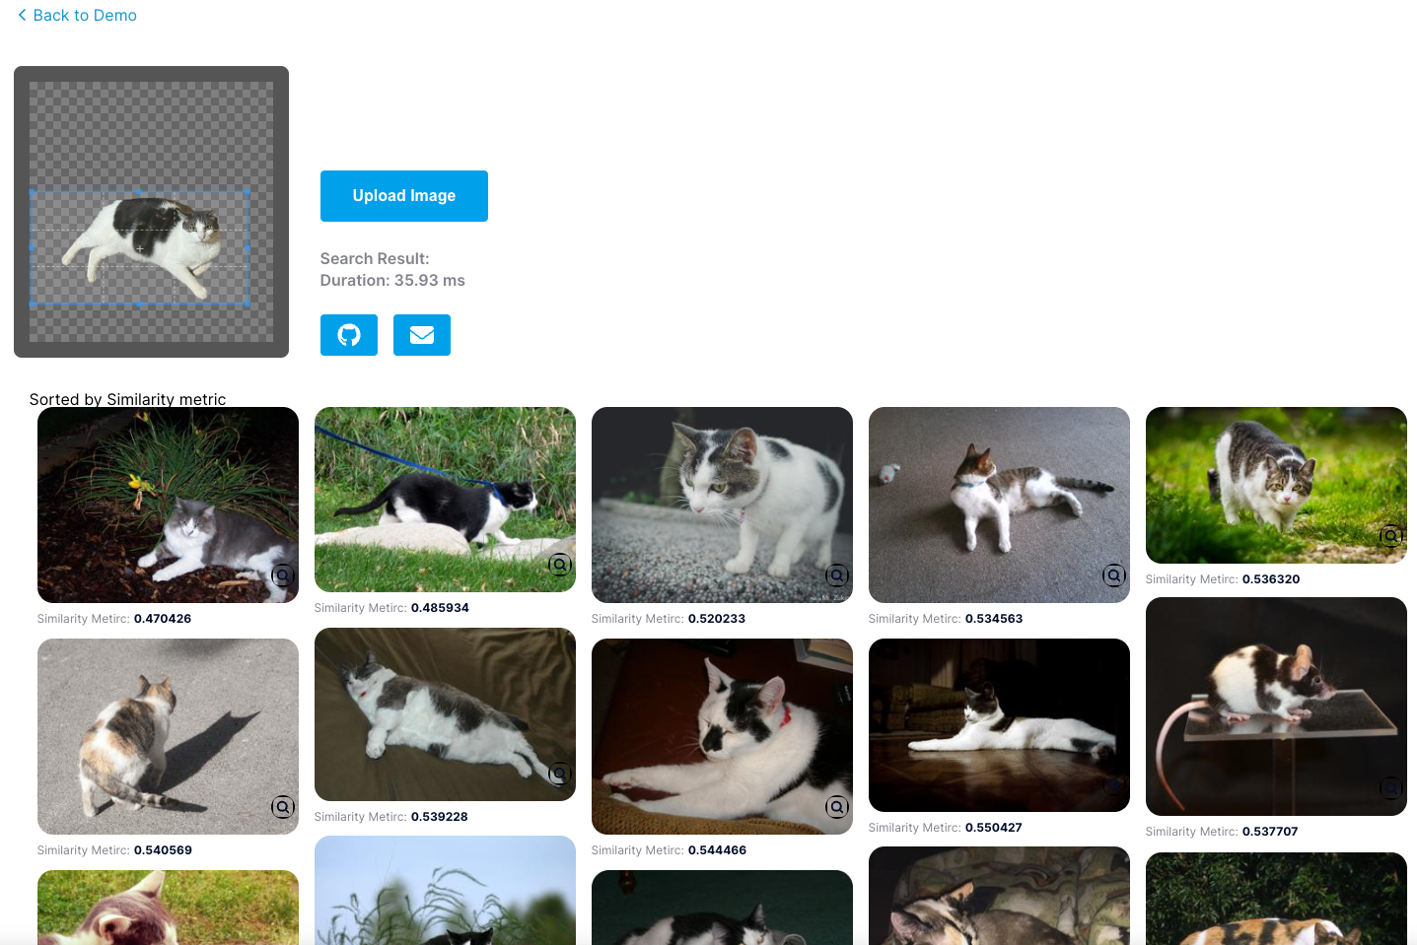

Show Me
https://milvus.io/milvus-demos/reverse-image-search

Slide 22


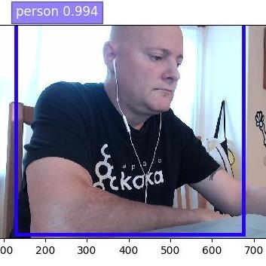
Vector Database Resources
Give Milvus a Star!
Chat with me on Discord!
https://github.com/milvus-io/milvus

Slide 23

.NET Conf: Focus on AI
Learn more
aka.ms/dotnetFocusAI/Collection

Slide 24
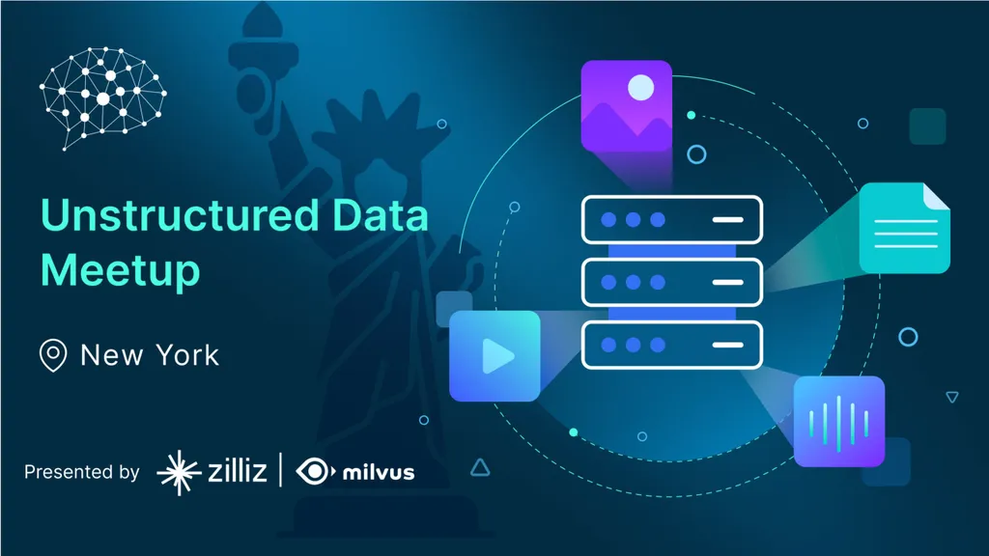


Unstructured Data Meetup
https://www.meetup.com/unstructured-data-meetup-new-york/
This meetup is for people working in unstructured data. Speakers will come present about related topics such as vector databases, LLMs, and managing data at scale. The intended audience of this group includes roles like machine learning engineers, data scientists, data engineers, software engineers, and PMs.
This meetup was formerly Milvus Meetup, and is sponsored by Zilliz maintainers of Milvus.

Slide 25

Getting Started with Vector Databases
Milvus
Open Source Self-Managed
Zilliz Cloud
SaaS Fully-Managed
github.com/milvus-io/milvus
zilliz.com/cloud

